Slide 1
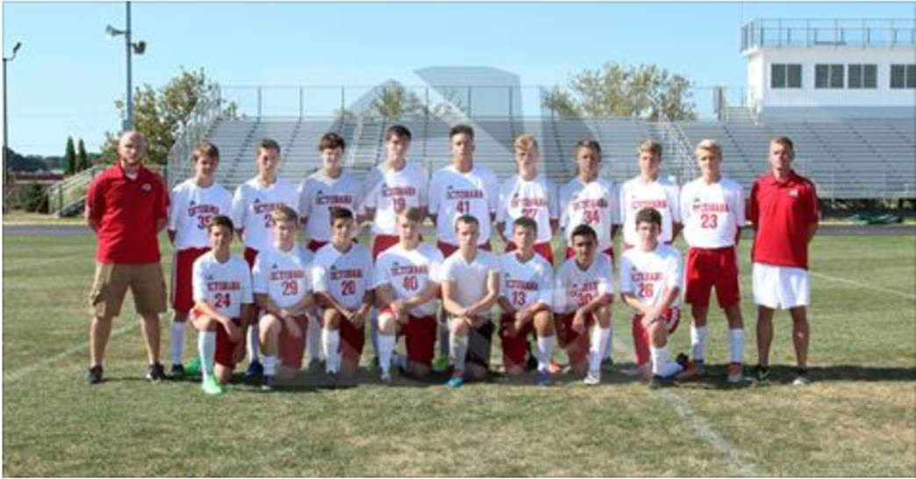
Philippians 2.12-18

Slide 2
1.27-2.4: Live worthy of the gospel!
stand firm in unity, defending your faith in the gospel truth;
be willing to sacrifice and suffer for Christ, pursuing the purpose of the gospel mission;
give up selfish ambition and vanity, rather being humble, loving and caring for each other.
2.5-11: Christ modeled this for us!

Slide 3
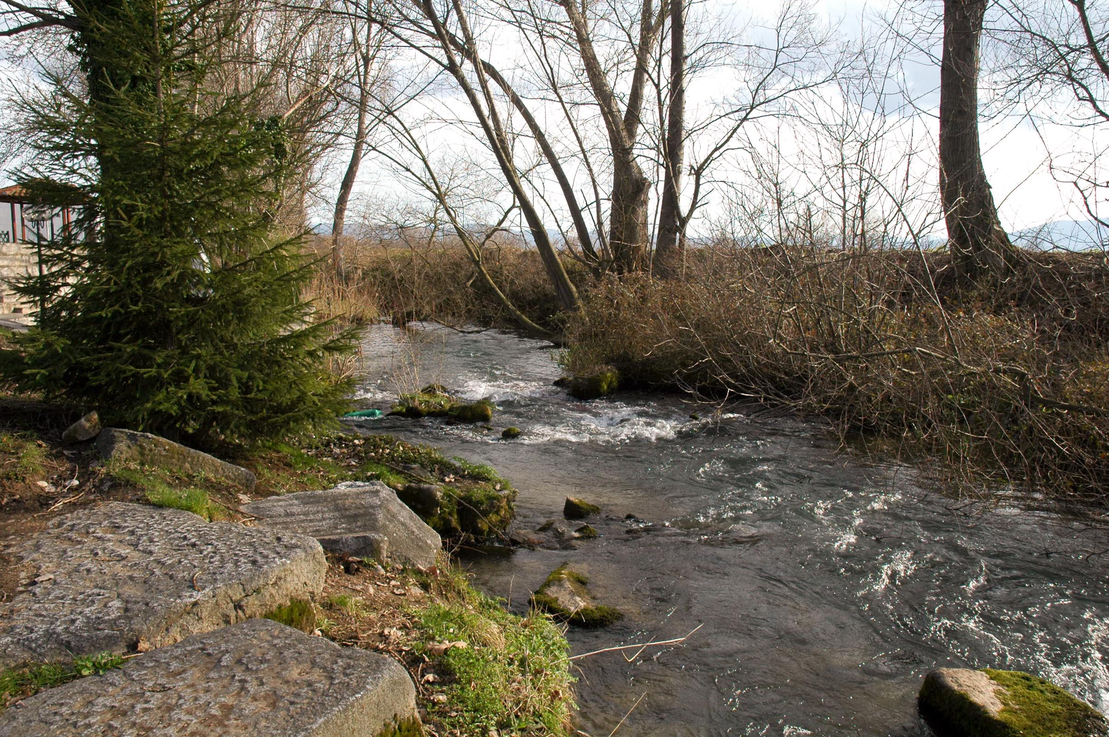
Philippians 2.12-13 NET: So then, my dear friends, just as you have always obeyed, not only in my presence but even more in my absence, continue working out your salvation with awe and reverence, for the one bringing forth in you both the desire and the effort– for the sake of his good pleasure– is God.
Where Paul & Timothy likely started evangelizing and baptizing in Philippi
©2012 Todd Bolen / BiblePlaces.com

Slide 4
Philippians 2.12-13 NET: So then, my dear friends, just as you have always obeyed, not only in my presence but even more in my absence, continue working out your salvation with awe and reverence, for the one bringing forth in you both the desire and the effort– for the sake of his good pleasure– is God.
A. Christ was selfless, humble, and obedient, to sacrifice and suffer for the gospel mission.
B. So then, they should continue working out their salvation by being obedient.
C. God will transform them to be willing and to make the effort, for his good pleasure.

Slide 5
Philippians 2.12-13 NET: So then, my dear friends, just as you have always obeyed, not only in my presence but even more in my absence, continue working out your salvation with awe and reverence, for the one bringing forth in you both the desire and the effort– for the sake of his good pleasure– is God.

Slide 6
Philippians 2.12-13 NET: So then, my dear friends, just as you have always obeyed, not only in my presence but even more in my absence, continue working out your salvation with awe and reverence, for the one bringing forth in you both the desire and the effort– for the sake of his good pleasure– is God.

Slide 7
2.12-13: continue working out your salvation
Justification [declared legally righteous]
Instantaneous; new spiritual life
Forever assures salvation from condemnation

Slide 8
2.12-13: continue working out your salvation
Justification [declared legally righteous]
Instantaneous; new spiritual life
Forever assures salvation from condemnation
Sanctification [transformed to live righteously]
Progressive process over our lifetime
Renewal of mind ➔ transformation of character
➔ change in our way of life.
Glorification [completion of purification]
At death for our soul
At resurrection for our body

Slide 9
2.12-13: continue working out your salvation
Perfection of Christ
Growth Over Time
Fleshiness of new believer

Slide 10
Philippians 2.12-13 NET: So then, my dear friends, just as you have always obeyed, not only in my presence but even more in my absence, continue working out your salvation with awe and reverence, for the one bringing forth in you both the desire and the effort– for the sake of his good pleasure– is God.
God renews our mind which transforms our character.
produces our desire to do what is right
produces our effort to do what is right
This is for God’s good pleasure.
creates his representative people
transforms us into who he created/saved us to be.

Slide 11
Philippians 2.12-13 NET: So then, my dear friends, just as you have always obeyed, not only in my presence but even more in my absence, continue working out your salvation with awe and reverence, for the one bringing forth in you both the desire and the effort– for the sake of his good pleasure– is God.
We must choose to desire this change in ourselves.
submit to Christ and obey him
yield to the leading of the Holy Spirit
engage with God through spiritual disciplines
participate in biblical fellowship and service

Slide 12
Philippians 2.12-13 NET: So then, my dear friends, just as you have always obeyed, not only in my presence but even more in my absence, continue working out your salvation with awe and reverence, for the one bringing forth in you both the desire and the effort– for the sake of his good pleasure– is God.
Φόβος = fear / fright or reverence / respect
τρόμος = trembling
[which implies Φόβος = fear here]

Slide 13
Philippians 2.14-16 NET: Do everything without grumbling or arguing, so that you may be blameless and pure, children of God without blemish though you live in a crooked and perverse society, in which you shine as lights in the world by holding on to the word of life so that on the day of Christ I will have a reason to boast that I did not run in vain nor labor in vain.

Slide 14
Philippians 2.14-16 NET: Do everything without grumbling or arguing, so that you may be blameless and pure, children of God without blemish though you live in a crooked and perverse society, in which you shine as lights in the world by holding on to the word of life so that on the day of Christ I will have a reason to boast that I did not run in vain nor labor in vain.

Slide 15
Philippians 2.14-16 NET: Do everything without grumbling or arguing, so that you may be blameless and pure, children of God without blemish though you live in a crooked and perverse society, in which you shine as lights in the world by holding on to the word of life so that on the day of Christ I will have a reason to boast that I did not run in vain nor labor in vain.

Slide 16
Philippians 2.14-16 NET: Do everything without grumbling or arguing, so that you may be blameless and pure, children of God without blemish though you live in a crooked and perverse society, in which you shine as lights in the world by holding on to the word of life so that on the day of Christ I will have a reason to boast that I did not run in vain nor labor in vain.

Slide 17
Philippians 2.14-16 NET: Do everything without grumbling or arguing, so that you may be blameless and pure, children of God without blemish though you live in a crooked and perverse society, in which you shine as lights in the world by holding on to the word of life so that on the day of Christ I will have a reason to boast that I did not run in vain nor labor in vain.

Slide 18
Philippians 2.17-18 NET: But even if I am being poured out like a drink offering on the sacrifice and service of your faith, I am glad and rejoice together with all of you. And in the same way you also should be glad and rejoice together with me.

Slide 19
Philippians 2.17-18 NET: But even if I am being poured out like a drink offering on the sacrifice and service of your faith, I am glad and rejoice together with all of you. And in the same way you also should be glad and rejoice together with me.

